Slide 1

Chhattisgarh Swami Vivekanand Technical University University Teaching Department Department of Computer Science and Engineering
Presented By
Sneha Jha
Roll No. 19
Branch: Data science
Major Project Presentation
On
Stock Market Companion: Real-time Data, Hybrid Analysis, And Enhanced User Interaction
Guided by :-
Mr. Ramakant Ganjeshwar
Assistant Professor
Madhurima Rawat
Roll No. 42
Branch: Data science
Geetanshu Dev Meshram
Roll No. 43
Branch: Data science

Slide 2
Content
Problem Statement
Literature Review
Research Methodology
Expected Outcome
Discussions
Scope of Project
Progress So far

Slide 3
Research Objective
Comprehensive Stock Prediction System – Develop a vast and robust system for stock price forecasting and market insights.
Advanced ML Implementation – Utilize ARIMA, LSTM, and Transformer models to enhance predictive accuracy.
Automated Workflow Management – Integrate GitHub Actions for seamless data processing, model training, and deployment.
Data Science Workflow Optimization – Leverage Metaflow for efficient model versioning and pipeline management.
Realtime Insights & Alerts – Implement Power BI dashboards, AI-driven chatbots, and real-time mailing for automated stock analysis.

Slide 4
Problem Statement
Stock Market Volatility – Fluctuations make it challenging to predict stock prices accurately.
Integration of Diverse Data – Combining numerical stock data with financial news analysis is complex.
Real-time Data Processing – Ensuring fast and efficient handling of large timeseries datasets.
Scalability Issues – Managing increasing data volumes while maintaining system performance.
Automation in Stock Analysis – Need for AI-driven chatbots and automated insights for better decision-making.
Efficient Notification System – Automating alerts for market trends, stock changes, and predictive insights.

Slide 5
Literature Survey
Research Paper/Source | Description | Accuracy/RMSE score
Advanced Stock Price Forecasting/IET Research | Focuses on developing advanced deep learning models for live stock price predictions, introducing the Fast RNN model (RMSE: 0.02068, time: 3.35 sec). A hybrid model combining Fast RNN, CNN, and Bi-LSTM (RMSE: 0.02181, time: 18.18 sec) significantly outperforms ARIMA and FBProphet (RMSE: 0.796, 0.935). | Fast RNN: RMSE 0.02068 Hybrid model: RMSE 0.02181 ARIMA: RMSE 0.796 FBProphet: RMSE 0.935
Dealing with Nonlinearity in Stock Prices/ MDPI | Evaluates the MVL-SVM model, integrating multi-view learning with SVM for stock price prediction, achieving nearly 88% accuracy, outperforming ARIMA and traditional SVM (accuracies around 70%). MVL-SVM model based on news and daily returns shows average and median accuracies above 0.8767. | Accuracy: nearly 88%
Hybrid Model for Stock Price Prediction/MDPI | Presents a hybrid model combining Prediction Rule Ensembles (PRE) and Deep Neural Network (DNN) techniques. Utilizes moving average indicators over 20, 50, and 200 days, achieving RMSE of 5.60 for ICICI Bank and 6.30 for SBI Bank, with RMSE scores 5% to 7% lower than existing DNN and ANN models. | ICICI Bank: RMSE 5.60<br>SBI Bank: RMSE 6.30

Slide 6
Research Methodology
Data Collection & Storage: Gather historical stock prices, financial reports, and market news, then store them efficiently using InfluxDB.
Model Implementation: Apply ARIMA, LSTM, and Transformer models for trend analysis and stock price prediction.
Workflow Automation: Utilize GitHub Actions and Metaflow to automate data processing, model training, and deployment.
Data Visualization: Use Power BI and Grafana to create interactive dashboards for real-time stock analysis and insights.
Real-time Deployment: Deploy AI chatbots for automated stock analysis using Streamlit and implement a mailing system for real-time market alerts.

Slide 7
Expected Outcome/Outcome
Adoption of Advanced ML Techniques: Implement ARIMA, LSTM, and Transformer models to enhance stock price prediction.
GitHub Actions: Automate workflows for data processing, model training, and deployment.
Metaflow: Streamline data science workflows and manage model versioning.
Power BI: Create interactive dashboards for stock analysis and insights.
Real-life Chatbots & Systems: Develop AI-driven chatbots for automated stock analysis.
Realtime Mailing Integration: Automate stock alerts, market trends, and predictive insights via emails.

Slide 8
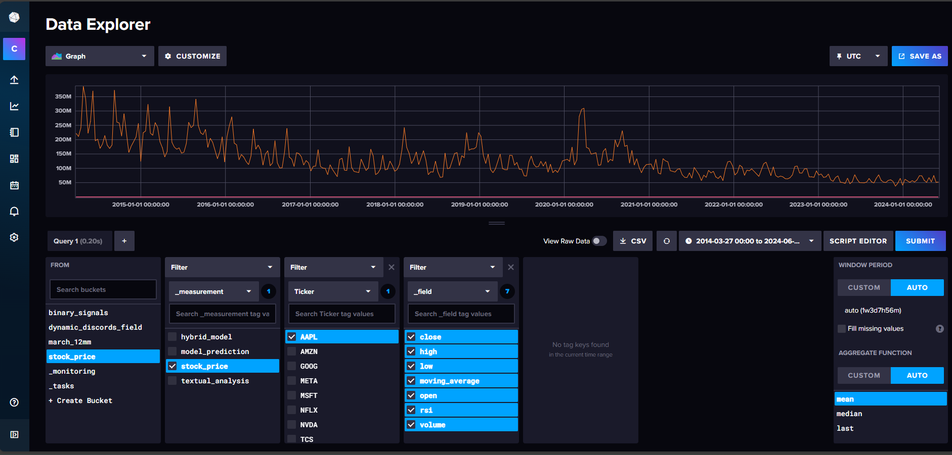
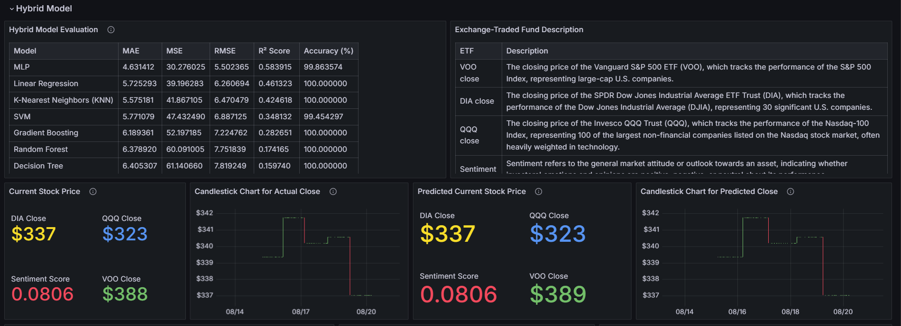
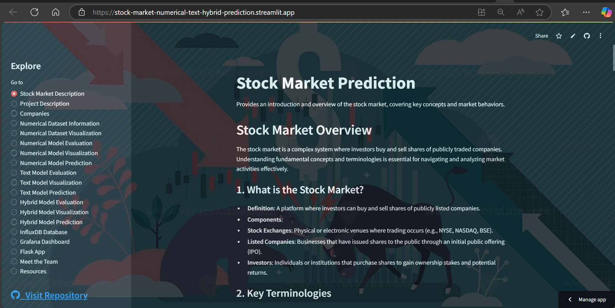
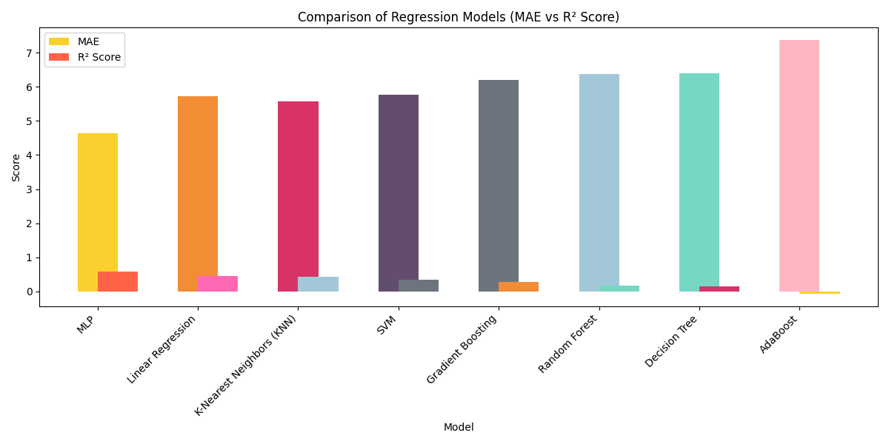
Result/Discussions
It focuses on Stock Market Prediction using a hybrid model that combines numerical and textual analysis. InfluxDB is used for time-series data storage, and Grafana provides real-time visualizations. Flask powers the backend, while Streamlit creates the interactive web app.

Slide 9
Scope of Project
Advanced Stock Prediction: Enhance forecasting accuracy using ARIMA, LSTM, and Transformer models.
Automated Workflows: Integrate GitHub Actions and Metaflow for seamless data processing and model deployment.
Comprehensive Data Management: Store and manage stock data efficiently using InfluxDB.
Interactive Data Visualization: Utilize Power BI and Grafana for real-time market insights and trend analysis.
AI-driven Automation: Deploy Streamlit-based applications, chatbots, and real-time mailing systems for stock alerts and insights.

Slide 10
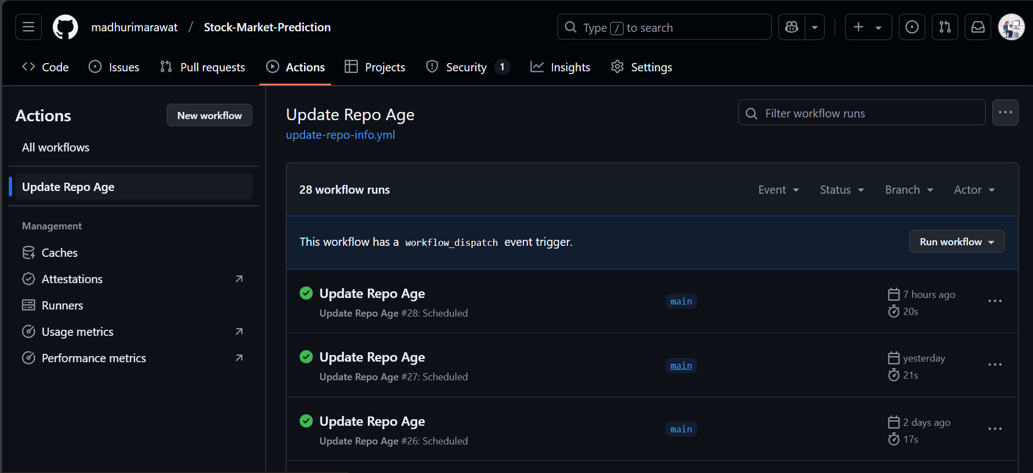
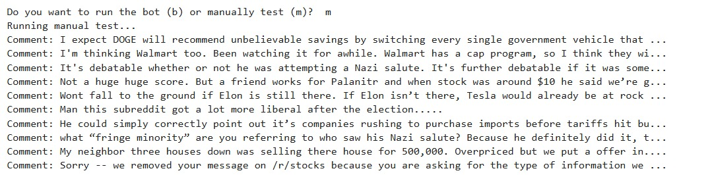
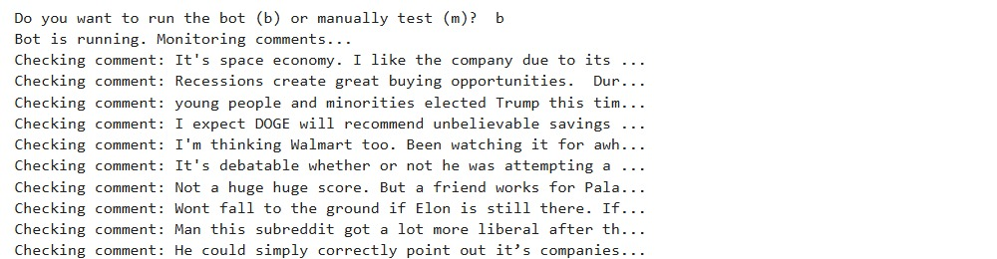
Progress So far
GitHub Actions Integration: Initial setup is completed, and testing has started on the repository before full integration into the codebase.
Metaflow Documentation: Currently being reviewed and will be completed soon for streamlined workflow management.
Power BI & Chatbot Development: A basic Power BI dashboard is created, with additional features planned, while the chatbot is in preparation using the current dataset for training.

Slide 11
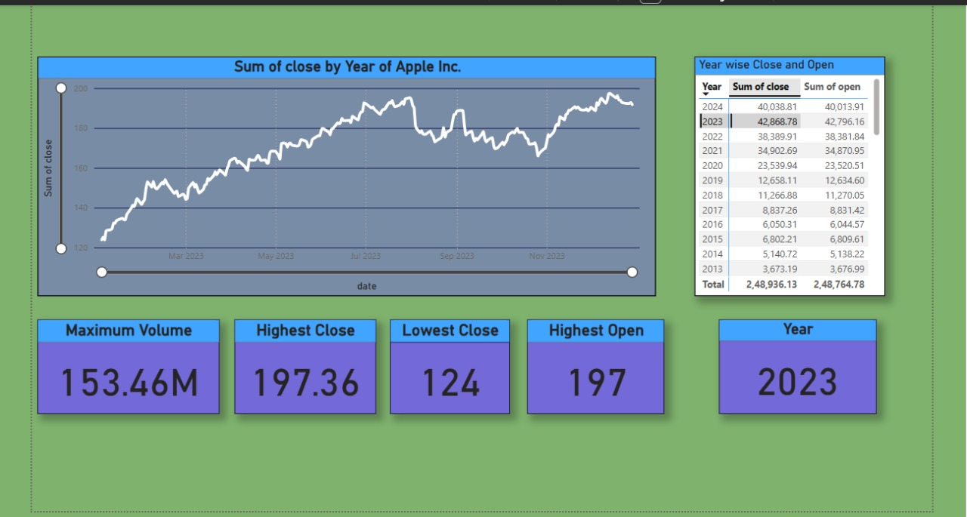
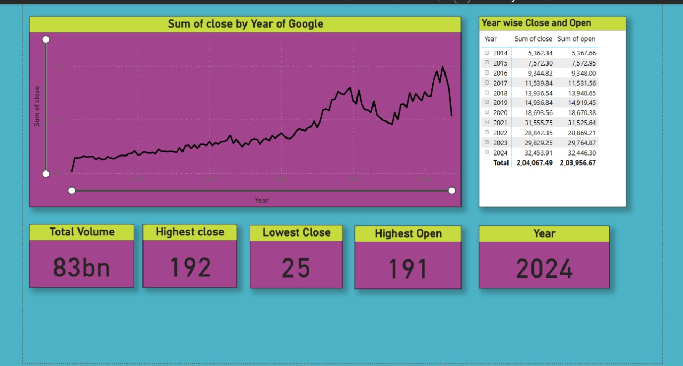
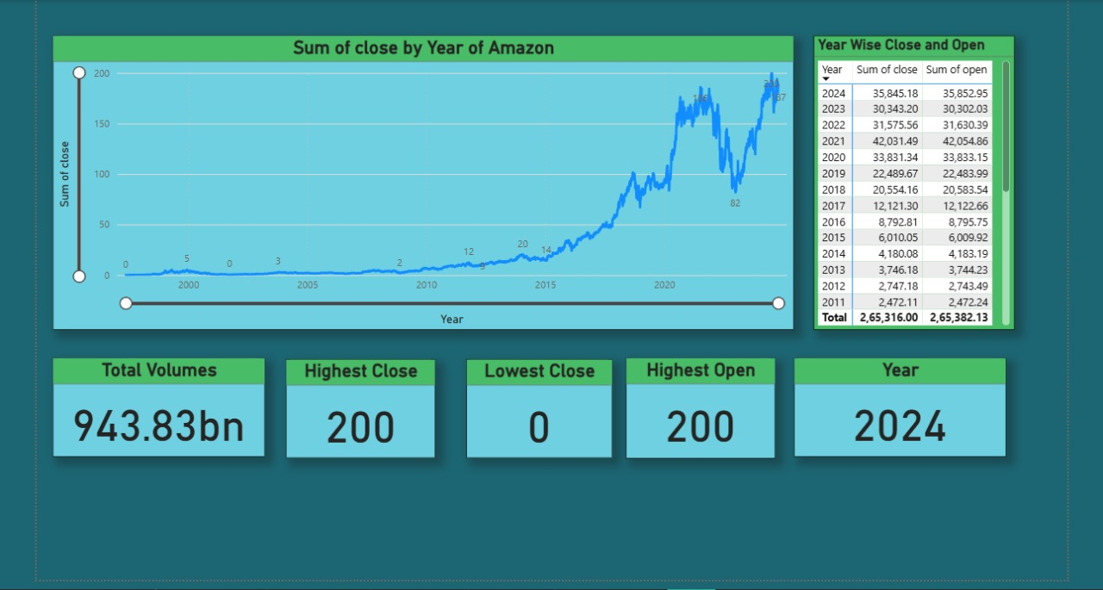
PowerBI Dashboard
The PowerBI dashboard outputs are as follows:

Slide 12
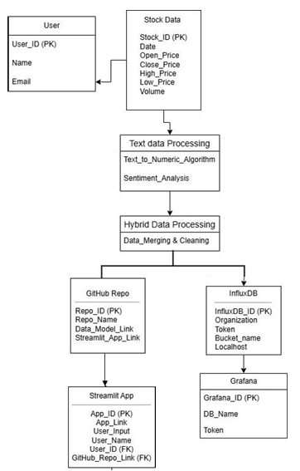
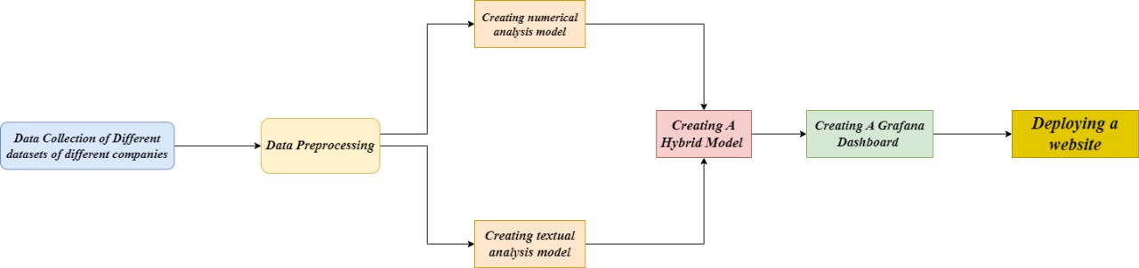
System Flowchart

Slide 13
References
Research Papers:
Yadav, K., Yadav, M., & Saini, S. (2021). Stock values predictions using deep learning based hybrid models. CAAI Transactions on Intelligence Technology, 6(3), 266-277. https://doi.org/10.1049/cit2.12052
Long, W., Gao, J., Bai, K., & others. (2024). A hybrid model for stock price prediction based on multi-view heterogeneous data. Financial Innovation, 10, 48. https://doi.org/10.1186/s40854-023-00519-w
Srivinay, Manujakshi, B. C., Kabadi, M. G., & Naik, N. (2022). A hybrid stock price prediction model based on PRE and deep neural network. Data, 7(5), 51. https://doi.org/10.3390/data7050051

Slide 14
Thank you

